Slide 1
Module 1:
Overview
Foundations of ML for Security
ML for Cybersecurity

Slide 2
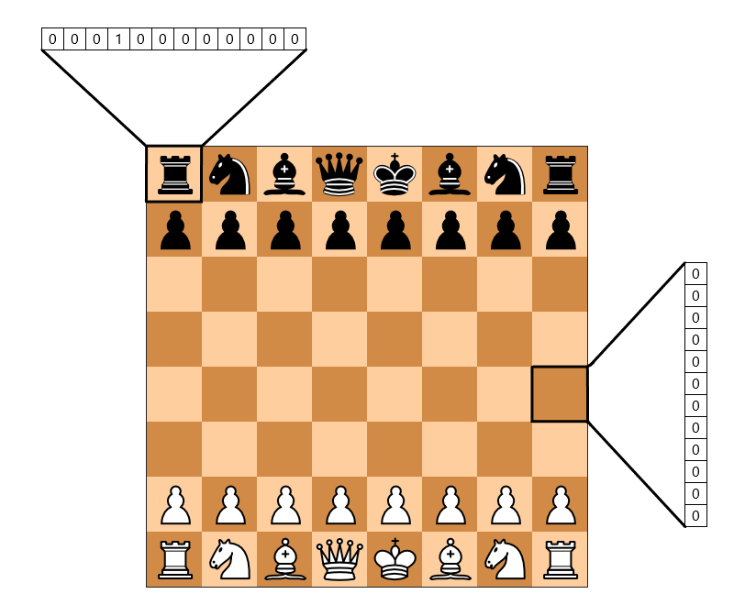



What is Machine Learning?
Automatic discovery of predictive rules from history

Slide 3
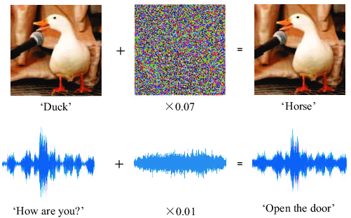

Machine Learning as a Tool for Cyber Security
Attacks – Learning – Defense
Machine learning for security
Security against attacks that exploit machine learning

Slide 4
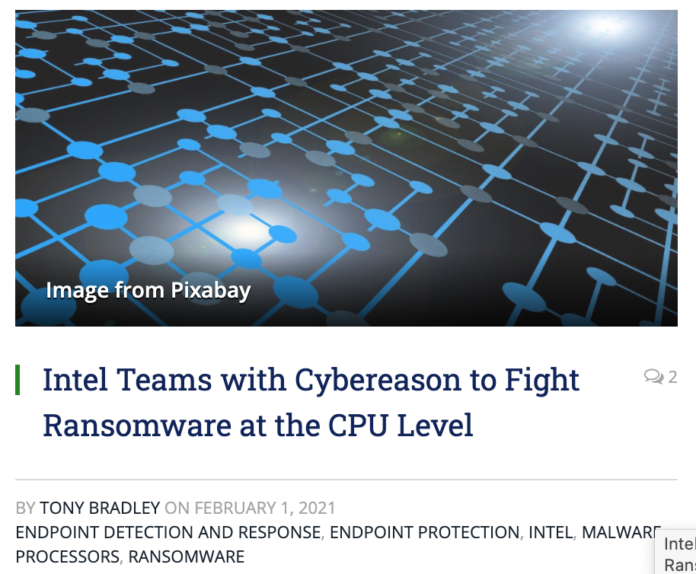
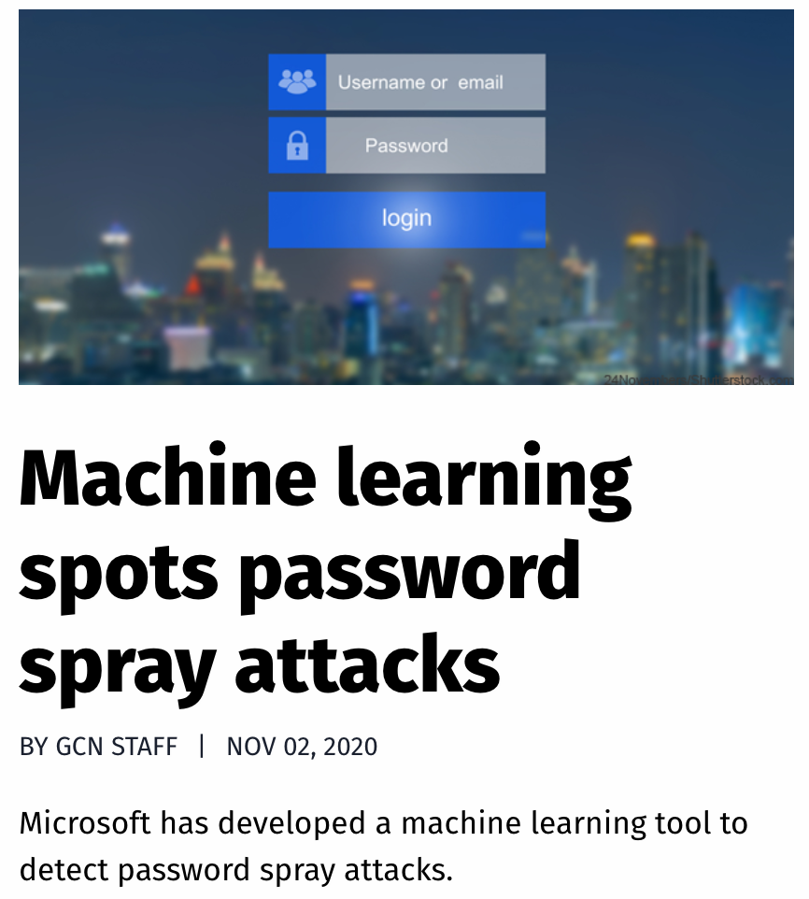
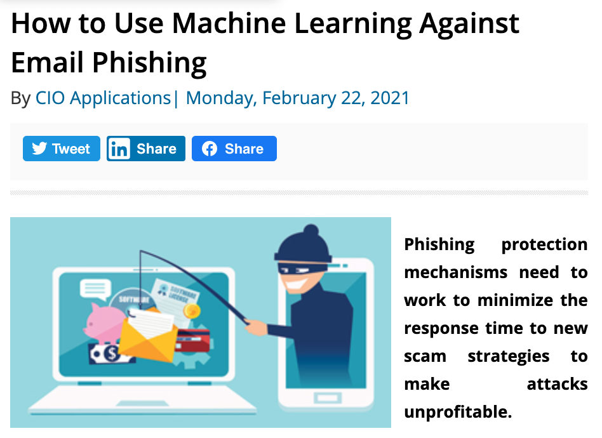
Machine Learning Use Cases

Slide 5
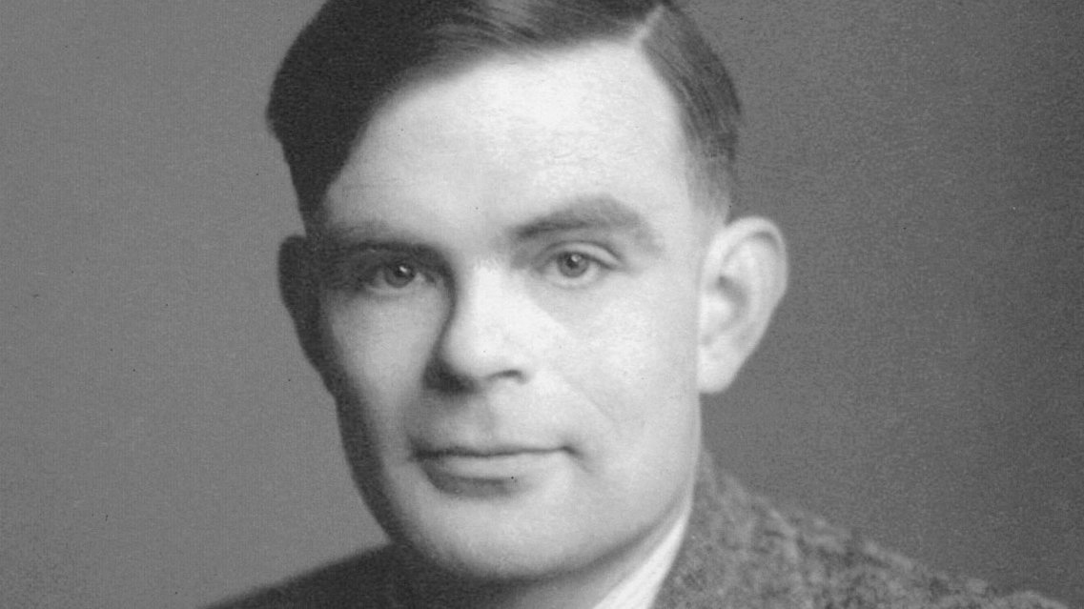
Definition of Machine learning
Alan Turing, 1947:
"what we want is a machine that can learn from experience." London Mathematical Society.

Slide 6

Definition of Machine learning
Arthur Samuel, 1952:
"Machine learning is the ability to learn without being explicitly programmed"

Slide 7
A Brief History
1950: Alan Turing created the world-famous Turing Test — “The Imitation Game”
1952: Arthur Samuel coined the phrase “machine learning”, and create a computer program that improves checkers game
1956: The Dartmouth workshop started AI as a field (John McCarthy, Marvin Minsky, Nathaniel Rochester, Claude Shannon …)
1958: Frank Rosenblatt designed the first artificial neural network
1986: Geoffrey Hinton introduced backpropagation which enabled monumental leaps in ANNs
1995: Cortes and Vapnik “standardized” support vector machines
1997: Deep Blue beats a chess champion
1999: Computer-aided diagnosis catches more cancers (CAD Prototype at UChicago)
2009: Launch of ImageNet
2011: Watson competed on Jeopardy! and won against Ken Jennings and Brad Rutter
2012: AlexNet won the ImageNet competition, which led to the use of GPUs and Convolutional Neural Networks in machine learning
2016: AlphaGo defeated the human champion Lee Sedol in a best-of-five duel match
…
Now: AI dominates Silicon Valley and becomes pervasive
https://cloud.withgoogle.com/build/data-analytics/explore-history-machine-learning/

Slide 8
Related Domains & Disciplines
Philosophy
Causality
Cybersecurity
Information Theory
Healthcare
Statistics
Machine Learning
Cyber-physical System
Algorithms
Neural-Informatics
Sciences
Optimization
Finance
…

Slide 9
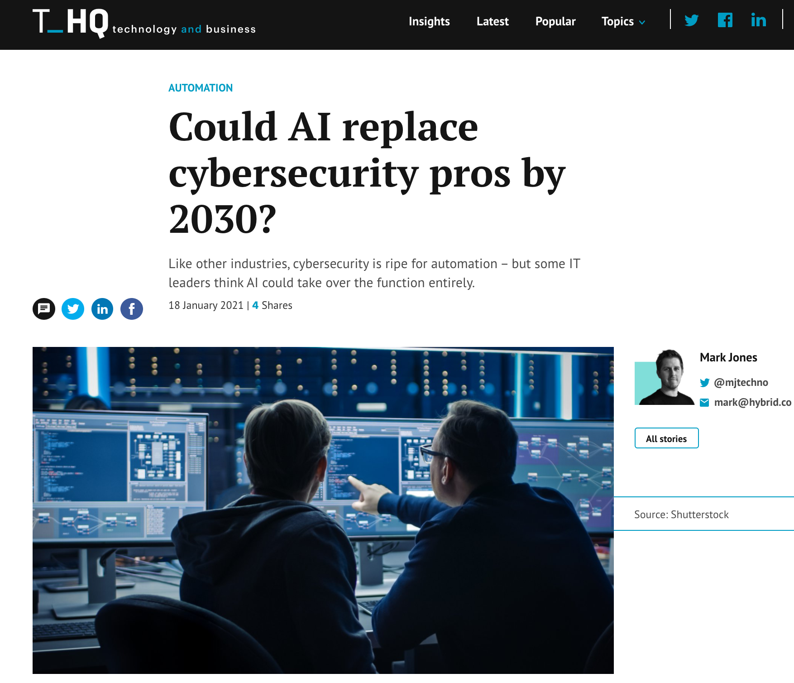

Slide 10
Module Overview

Slide 11
Adversaries
Ethics
Attacker’s goals
Attacker’s capabilities
Robustness of model/feature
Privacy
Fairness
Transparency
Modules 2 – 4
Module 4
Module 2
Module 1
Identify Goals & Collect Data
Data Representation
Modeling
Deployment
Pinpoint needs
Data acquisition
Data labeling
Data exploration
Data cleaning
Missing data
Feature selection
Consider fairness
Efficiency
Accuracy
Interpretability
Adversarial resistance
Performance
Evasion and attacks
Model drift
Impact on stakeholders
Module 3

Slide 12

Foundations of “Modeling”
Machine learning pipeline
The statistical learning framework
Generative & discriminative modeling
Basic supervised learning models
Logistic regression
Naïve Bayes
Neural nets
Unsupervised learning
Dimensionality reduction
Clustering
Credit @NOELIAGOROD

Slide 13
Learning Objective

Slide 14
After participating in this module, you will
Understand the basic concepts underlying the practice of ML
Identify practical scenarios…
where ML can play a key role in cybersecurity
Analyze ML models using statistical tools …
and choose the best model for a use case!
Implement for security applications a variety of ML models
E.g., from classical approaches such as logistic regression to representation learning methods such as convolutional neural networks

Slide 15
Rest of this module
Pre-recorded video lectures
The statistical learning framework
Supervised learning
Neural networks and deep learning
Unsupervised learning
A primer to ML in python
Exercises and extended reading materials
In-class discussions

